Slide 1
Sense Groups / Thought Groups and Emphasis Markers

Slide 2
Change in meaning with punctuation
DO YOU WANT TO EAT JOHN?
DO YOU WANT TO EAT, JOHN?

Slide 3
Q: DO YOU WANT TO TAKE TEA?
A: I DON’T NO. (Sounds like, “I don’t ‘KNOW’”)
v/s
I DON’T, NO. (The person does not want to take tea, a perfect answer to the question.)

Slide 4
A woman without her man is nothing.
A woman/ without her/ man is nothing.
V/s
A woman without her man/ is nothing.

Slide 5
What are THOUGHT GROUPS?
A group of words that express a meaningful idea or thought.
GROUPS OF WORDS that make sense together.
I’m sorry but/I have a/conflict and I/can’t make the coffee.
OR,
I’m sorry/but I have a conflict/and I can’t make the coffee.

Slide 6
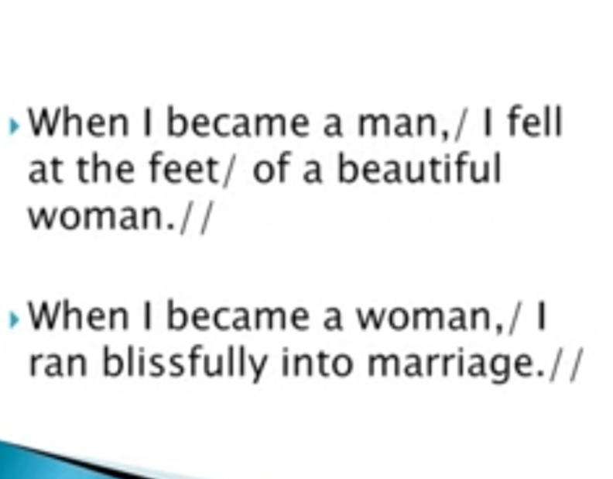

Slide 7
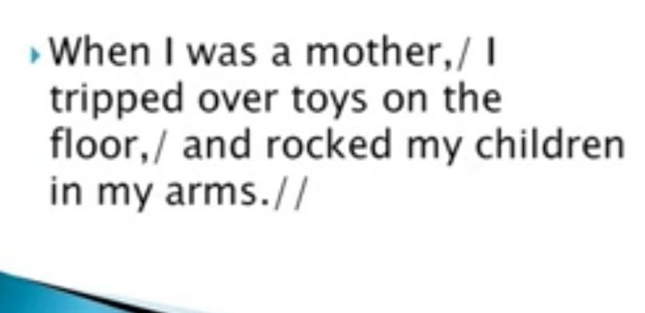

Slide 8
THOUGHT GROUP RULES :
1. There is often a pause at the end of a thought group to signal that the thought group is finished.
2. Intonation must end by falling.
My brother/bought me/a new bicycle.

Slide 9
The government of India said the Chief Minister of Maharshtra has grossly neglected the incidence of Covid-19.
The government of India/ said the Chief Minister of Maharshtra/ has grossly neglected/ the incidence of Covid-19.
Vs
The government of India said/ the Chief Minister of Maharshtra / has grossly neglected/ the incidence of Covid-19.

Slide 10
4. The prince said the princess had been unfaithful.
4a. The prince said / the princess had been unfaithful./
Meaning: The prince said (that) the princess had been unfaithful.
4b. / The prince / said the princess / had been unfaithful./
Meaning: "The prince," said the princess, "had been unfaithful."

Slide 11

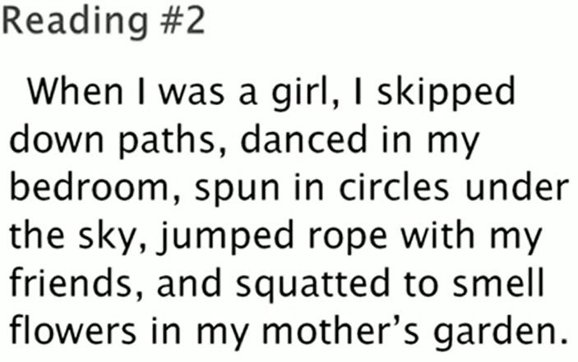

Slide 12
Sense Groups/Thought Groups
A group or sequence of words conveying a particular meaning or idea
Allow you to organize your speech into groups of words that make up a single idea
Help your listener(s) better understand the information in your speech by organizing your ideas into comprehensible “packages”
Different speakers can and do use thought groups differently

Slide 13
Identifying Thought Groups
Punctuation
When we read aloud, the writer’s punctuation tells us where to pause:
comma = ,
period = .
semicolon = ;
colon = :

Slide 14
Cont…
2. Grammar
Identification of grammatical units in a sentence
Pausing between larger grammatical units creates natural rhythm

Slide 15
Grammatical Units
Noun phrases
the blue-eyed girl
Verb phrases
have been studying
Prepositional phrases
on the table
Clauses
When I was a student, I studied for hours.

Slide 16
Read
A blue-eyed girl/ entered the classroom.//
A blue-eyed girl/ and her best friend/ entered the room.//
The blue-eyed girl/ is playing with her brother.//
The teacher,/ whom I loved most,/ has resigned.//

Slide 17
Avoid breaking up short sentences
I came.
Vs
I came, I saw, I conquered.
I danced.
Vs
I danced in the auditorium.

Slide 18
Focus Word
Usually the last content word in the thought group.
Is usually louder and longer For example:
The first item/ on our agenda/ is to address parking.

Slide 19
Identify (1) the most likely thought group boundaries and (2) the focus word in each thought group
I’d like to introduce my wife Nita.
If you take care of the accounts I’ll handle the meeting.
Microsoft CEO Satya Nadella started a charity to fight poverty.
My new phone is acting up so could you email me instead?

Slide 20
Answers
I’d like to introduce my wife/ Nita.
If you take care of the accounts/ I’ll handle the meeting.
Microsoft CEO Satya Nadella/started a charity/ to fight poverty.
My new phone is acting up/ so could you email me instead?

Slide 21
Emphasis (in Reading and Writing)

Slide 22
I DIDN’T SAY YOU STOLE THE MONEY I DIDN’T SAY YOU STOLE THE MONEY I DIDN’T SAY YOU STOLE THE MONEY I DIDN’T SAY YOU STOLE THE MONEY I DIDN’T SAY YOU STOLE THE MONEY I DIDN’T SAY YOU STOLE THE MONEY I DIDN’T SAY YOU STOLE THE MONEY CONNOTATIVE AND DENOTATIVE MEANING - VARIES

Slide 23
Emphasis
the extra force that you give to a word or part of a word when you utter it
to reinforce or to give special meaning to the part of an utterance
the emphasized part(s) of a sentence is/are louder and longer.

Slide 24
A. I want a red rose.
B. I want a red rose.
C. I want a red rose.

Slide 25
I want a ripe mango.
I want a ripe mango.
I want a ripe mango.

